Slide 1


Day 05
contact@anubhavtrainings.com
ABAP RESTFUL APPLICATION PROGRAMMING

Slide 2

Agenda – Day 05
What is EML ?
Why we use EML
Syntax of EML
C-R-U-D Using EML
Implementation of EML
Introduction to Managed Scenario
Use Case for Managed Scenario
Describing Functionality of Scenario
Sequence Diagram
Implementing Create, Update and Delete
Make field read only
Making field Mandatory
Add validation to the code
Implement Actions - set_status_booked
Notes:
Managed Implementation – Demo Scenario
Projections
Flexible service consumption
Development flow – managed scenario
Implementation for processor scenario
Final processor Fiori App
Recap and Testing Composition
Implementing the Action createTravelByTemplate
Implementing the Action approveTravel
Implementing the Action rejectTravel
Modeling Static and Dynamic Feature Control
Implementing Validations
Implementing the Determination
What is Draft
Enable Draft Handling
Expose Draft handling to projection Layer
Enable Early Numbering for Travel and Booking
Integrating augment in Managed Object
Understand the persona for Approver
Implementing Approver projection
Annotations for Approver Scenario
Behavior Definition for Approver
Service Binding for Approver Scenario
Fiori App for Approver
Deploy Fiori App to SAP CF

Slide 3
What is EML ?
The Entity Manipulation Language (EML) is a part of the ABAP language that enables access to RAP business objects. Because the consumption of business objects via the OData protocol requires a Fiori UI or a web API, EML enables a type-safe access to business objects directly by using ABAP.
A Business Object in RESTful ABAP is consists of multiple Entities. This is a entity composition tree with one entity acting as a root. EML is part of the ABAP language and used in context of RESTful ABAP to control the BO behavior (create, read, update, delete).
We can use the EML in ABAP to test our BO. We can call the BO using EMP from ABAP program in 2 ways
01
Standard (Statically)
Generically (Dynamic) framework.
02

Slide 4
Syntax of EML
The EML provides us 3 important access statements for Data Manipulation using BO( Business Object ).
01
Perform the CUD ( Create ,Update ,Delete on BO
MODIFY ENTITIES OF RootEntityName
ENTITY EntityAliasName
[ CREATE FROM it_instance_c ]
[ UPDATE FROM it_instance_u ]
[ DELETE FROM it_instance_d ]
[ CREATE BY \AssociationName FROM it_instance_cba ]
[ RESULT et_result_tab ] [ FAILED failed ] [ REPORTED response ] [ MAPPED mapped ]
02
Commit Entities
Will actually persist the changes in the DB from transaction buffer. Any modify operation that are executed within behavior pool or by ABAP program are not causing any DB change because they are applied on transaction Buffer and this buffer content will disappear when ABAP session ends. So if we want the changes to be passed to SAVE SEQUENCE and persisted, we will use the COMMIT ENTITIES statement.
finalize ( )
check_before_save( )
Adjust_numbers( )
Save( )

Slide 5
Syntax of EML
03
Read the Data
All operations that do not need to change the data of an entity are carried out by READ Data.
There 2 types of Read
Read Entity by Key
Read Access to child (association) by parent key
Read Statement always returns the RESULT and you must specify target variable. We can also read the associated entity data using BY \asso_name FROM it_table syntax.
The result of associated data with come in another internal table LINK tab_name, it will always contain the key value pair.
READ ENTITIES OF RootEntityName
ENTITY EntityAlias FROM it_read_condition
RESULT et_result
BY \asso_name FROM it_read_rba
RESULT et_res_rba
LINK et_link_keys
ENTITY EntityAlias FROM it_ins_2…. [ FAILED failed ] [REPORTED reported]

Slide 6

Rule for EML
In addition to the data we also have a compiler generated field in input and output results called %control, this field is responsible to inform the RESTful framework that, which are all the fields we would like to send to DB while creation or update while updating. Also while read we can specify the same to avoid reading everything.
We can also see the complete BO structure in BO Explorer using keyboard shortcut :-
Alt+Shift+W

Slide 7
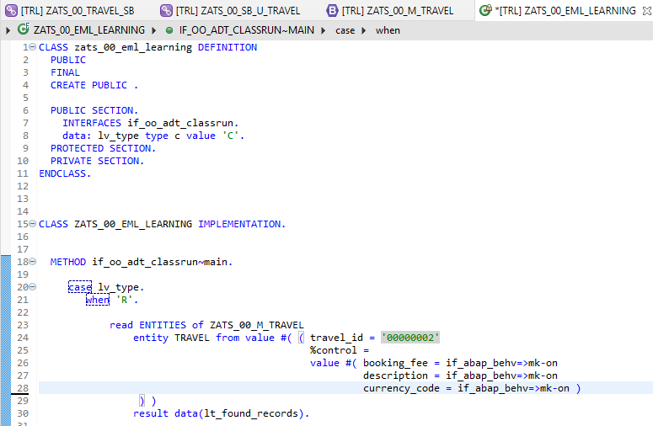
Implementing EML
Exercise
ZATS_00_EML_Learning

Slide 8
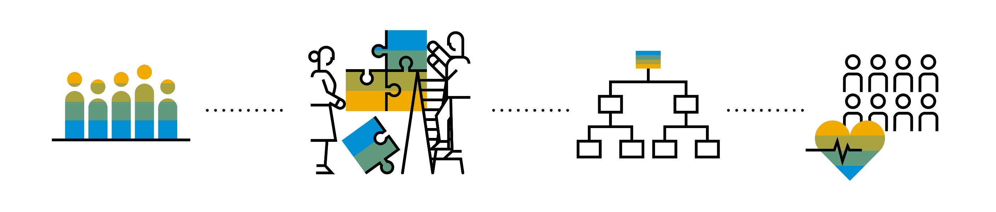
Introduction to Managed Scenario
Let us consider we have been given a green field and asked us to develop a villa from scratch with our own customization. So, what steps will be involved in it? We need to design the floor-plan of the villa, the sections we want to include in the house like pool area, a garden, a jogging track etc. And we will proceed with selecting materials, selecting vendors, enforcing conciliation and orders and many more steps. Similarly, the RAP’s managed scenario provides the greenfield development for our business object.
In the managed scenario, the implementations of behavioral elements like Create/Update/Delete are managed by the RAP framework itself. However, to implement complex logic like validations, determination or some sort of actions (Submit, Approval, Reject etc.) on the business entity, you need to add the ABAP logic for it in implementing classes.

Slide 9



Use Case for Managed Scenario
I am working as a ABAP on Cloud developer for one of the travel planner agency, which has just taken the BTP subscription. They want me to create 2 fiori apps for the travel industry
Processor Application
Approver Application
MakeMyTrip.com
Source → Destination
Start → End Date
How many
Travel Itinerary
Travel Request which has multiple Bookings
Create a travel request and add bookings with all the properties changeable
Updates booking fees and description and provide approvals
Processor
Approver

Slide 10

Steps for Build Use Case
Fiori App for Processor
Fiori App for Approver
Service Def and Binding
Service Def and Binding
CDS Data Model
CDS Projection for Processor @UI
CDS Data Model
CDS Data Model
CDS Projection for Approve @UI
Introduction
1..1
Behavior Def
Projection (processor)
Behavior definition
Behavior definition
Behavior Def
Projection (approver)
Behavior definition
Behavior Implement (pool)

Slide 11
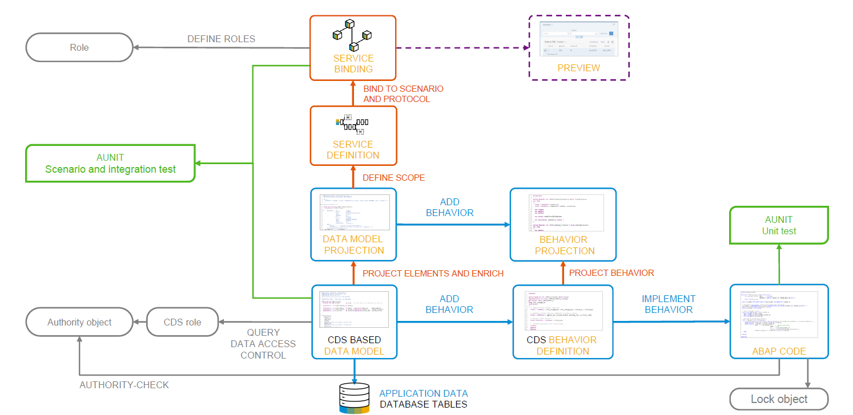
Development flow

Slide 12
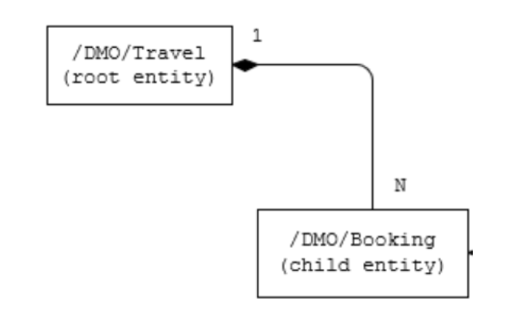
Our new Business Object
From a structural point of view, a business object consists of a tree of entities that are linked by compositions. Every entity in this composition tree is an element that is modeled with a CDS entity. For our demo travel booking scenario, we will implement a 2-level hierarchy composition tree.
As depicted in the figure below, the 2-tier entity hierarchy for managing transactional data in our scenario consists of the following editable entities, with a 1: N cardinality on each level:
Travel
Booking
i.e. each travel instance has 0..N bookings The figure below shows the composition relationship between the travel and the (flight) booking entities, where the travel entity represents the root of the data model.

Slide 13
Calculator
3rd – 6th
Addition, subtraction
Calculator
7 and above
Addition, multiplication, division
1 2 3
4 5 6
7 8 9
0 $
1 2 3
4 5 6
7 8 9
0 $
+
/
+
-
*
Projection
Projection
1 2 3
4 5 6
7 8 9
0 $
/
+
*
-

Slide 14
Our Demo Scenario
This demo scenario uses two projections with a different service scope. The resulting apps represent two role-based approaches to managing travels.
One business object projection uses the BO characteristics and the operations that are relevant for processing travel data. This resulting UI service serves the role of a data processor. The responsible person can enter the information about travels, bookings into the role-based app for processing travel data. This person needs functionality to create, update and delete entries on all three tiers of the business object. In addition, the action CreateByTravelTemplate is designed to facilitate the creation of new travel entries. The instance-bound action reads the values of the selected entry and creates a new entry based on these values with some deviations for the TravelID and the travel dates.
The other business object projection is the basis for a UI service that contains the functionality that is relevant for an approver. Imagine a person, maybe a manager of a travel agency, that approves the data that was entered by the processor. That means, this person sees the travel information and the corresponding booking data. Based on this data, the approver can either accept or reject the travel. For a minimal scope of fields in the travel entity the approver is enabled to edit the values, for example the BookingFee or the Description. The information about bookings is set to read-only for the approver. The approver is not allowed to change the fields of the booking entity.
Processor
Approver

Slide 15
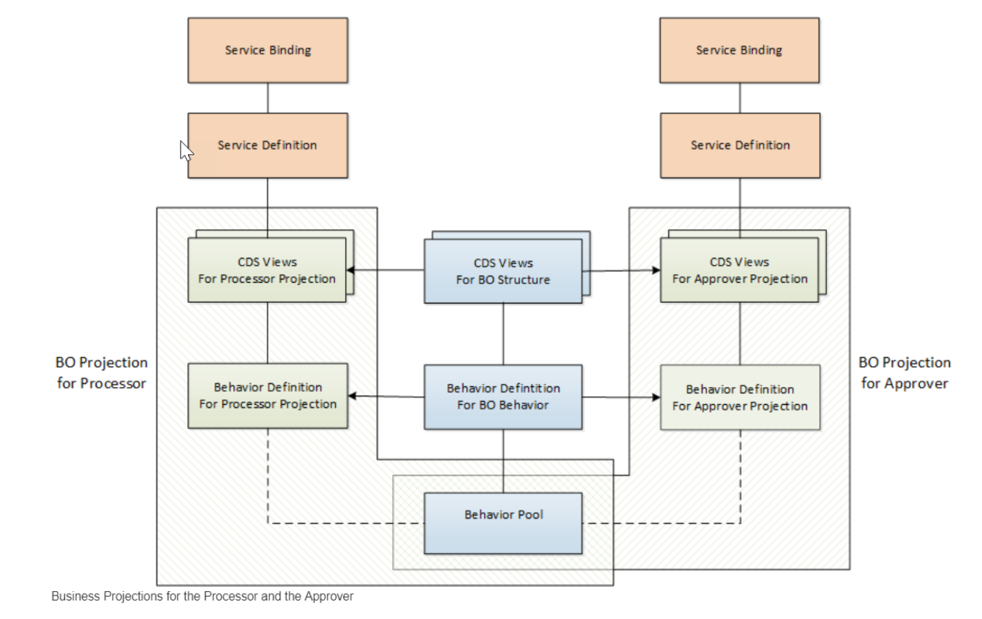
Projections

Slide 16
Introduction – Flexible Service Consumption
For a more flexible service consumption, every transactional business object is projected into a service specific context. In other words, only those elements of the data model and those behavior characteristics and operations that are needed in the relevant business service context are exposed for the service.
By means of projections, you can expose one BO in different business contexts by using different BO subsets. The general business logic is defined in the BO whereas the BO projection adopts a subset of the business logic.
A layering with projections enables robust application programming. You can change or enhance the BO without changing the exposed service as the scope of the service is defined in the projection layer. Enhancing the business object with additional structure or behavior does not have any effect on the resulting service.

Slide 17
Development Flow
4. Imp Behavior Definition on top of Projection View’s of Processor App.
7. Imp Behavior Definition on top of Projection View’s of Approver App.
2. Imp Behavior Definition on Travel.
6. Create Service Binding on top of Service Definition.
10. Create Service Binding on top of Service Definition .
1
3
5
7
9
2
4
6
8
10
1. Create Basic CDS View’s
For Travel & Booking.
3. Create Projection CDS on top of Basic View’s for Processor App.
5. Create Service Definition for Processor App.
7. Create Projection CDS on top of Basic View’s for Approver App.
9. Create Service Definition for Approver App.

Slide 18
Lose coupling
Both entities can co-exist w/o each other
Good to have relation
Tight Coupling
They come together
Must have relation

Slide 19
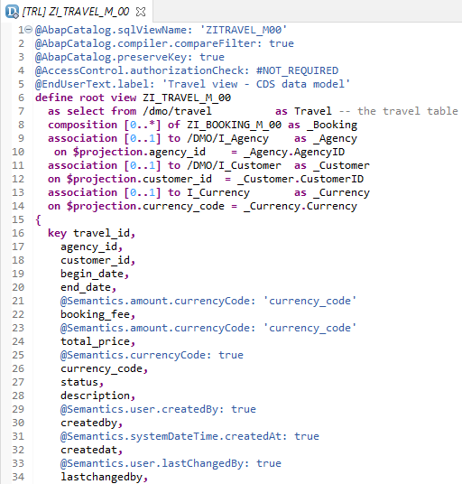
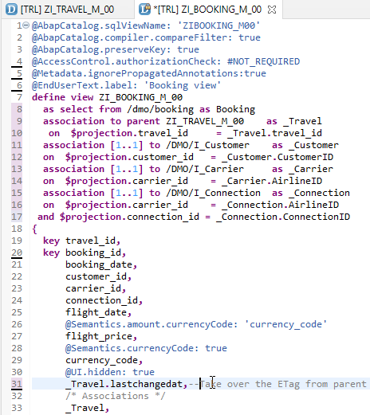
Create Base CDS View
ZI_TRAVEL_M_00
ZI_BOOKING_M_00

Slide 20
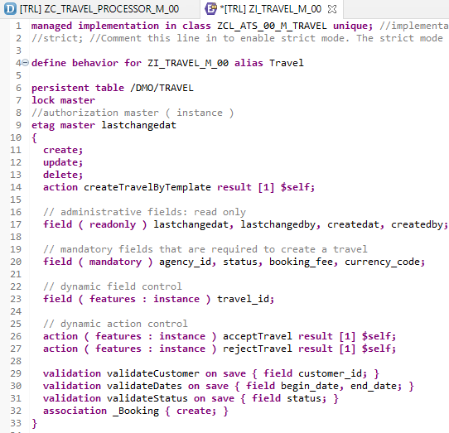
Implementing Base Behavior Definition
In the Project Explorer view of your ABAP project (or ABAP Cloud Project), select the node for the data definition that defines the root entity ZI_TRAVEL_M_XX. Open the context menu and choose New Behavior Definition to launch the behavior definition creation wizard.
“ZI_TRAVEL_M_00”
Behavior Definition for Base CDS’s Views .

Slide 21
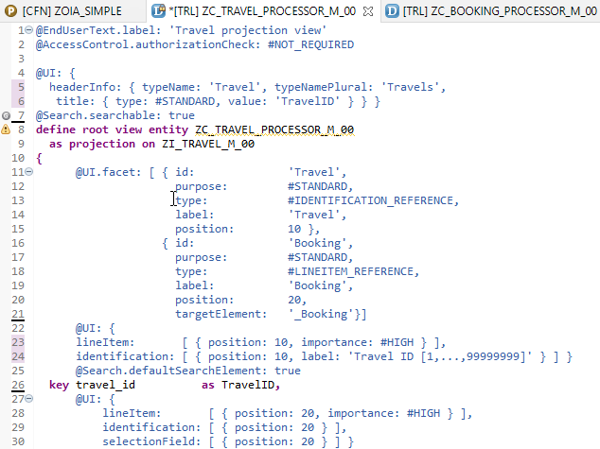
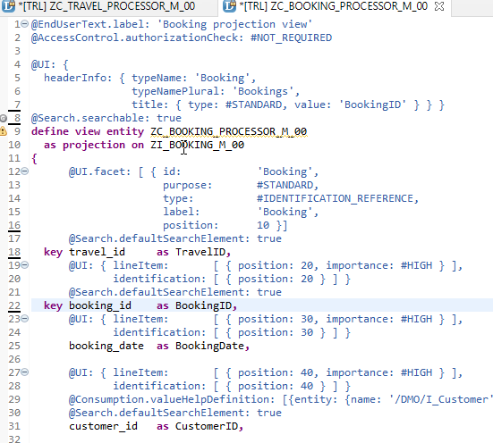
Projection CDS View’s for Processor
Projection CDS View for Travel Info “ZC_TRAVEL_PROCESSOR_M_00”
Projection CDS View for Booking Info “ZC_BOOKING_PROCESSOR_M_00”

Slide 22
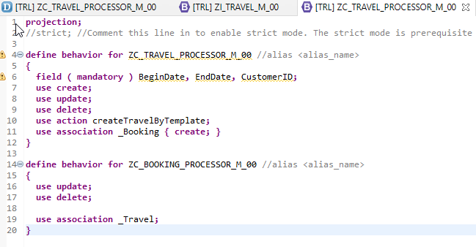
Behaviour Definition for Processor
The behavior for the BO projection is defined in a behavior definition of type projection. The type is defined in the behavior definition header. The projection behavior definition provides the behavior for the projection CDS view. All characteristics and operations that you want to include in the BO projection must be listed explicitly
“ZC_TRAVEL_PROCESSOR_M_00”
Behavior Definition for Projection CDS’s Views of Processor.

Slide 23
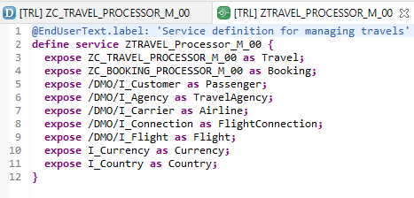
Service Definition
The service definition is a projection of the models and related behavior that you want to expose. In a service definition, you define the OData service to determine which CDS entities are part of the service. This service is then bound to a protocol and to either a UI technology or an A2X service by a service binding artifact. A service definition can be integrated in various protocols without any reimplementation.
Exercise
“ZTRAVEL_PROCESSOR_M_00”
Service Definition for Expose Entity

Slide 24
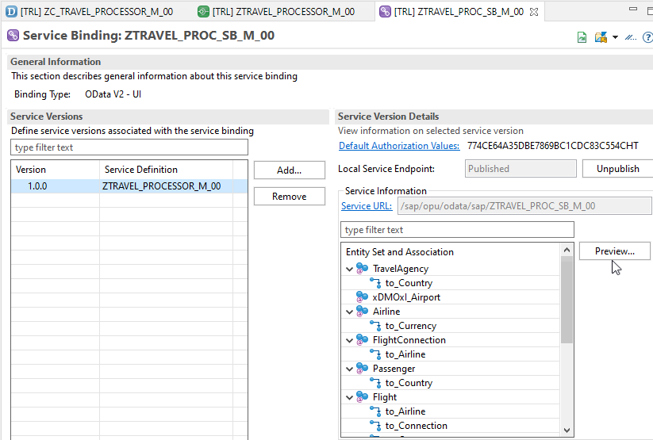
Service Binding (OData)
A service binding implements the protocol that is used for the OData service. It uses a service definition that projects the data models and their related behaviors to the service.
After Creating Service Binding , Select Entity and Click on Preview

Slide 25
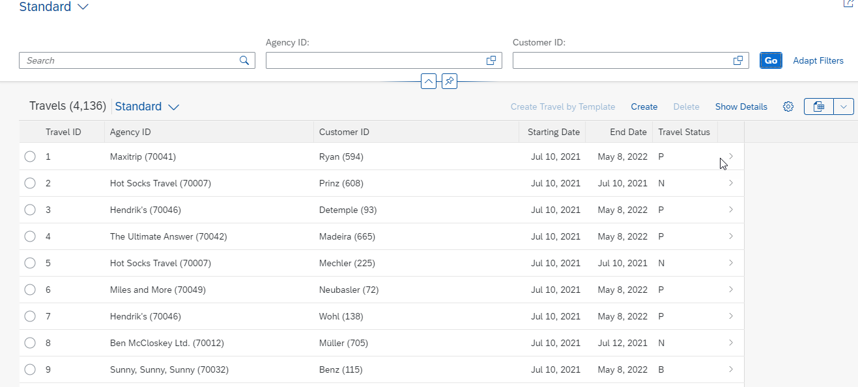
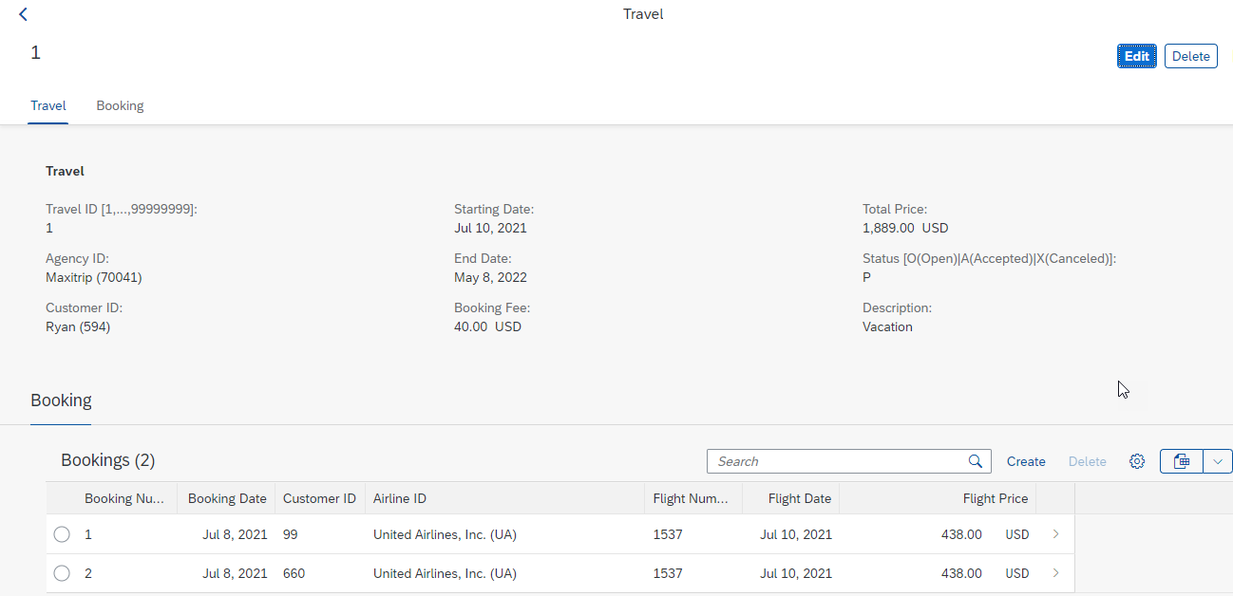
Final Result of Processor App
1st Screen with Search Bar & Filter Bar
2nd Screen with Travel and Booking Data,
& C-R-U-D Functionality

Slide 26
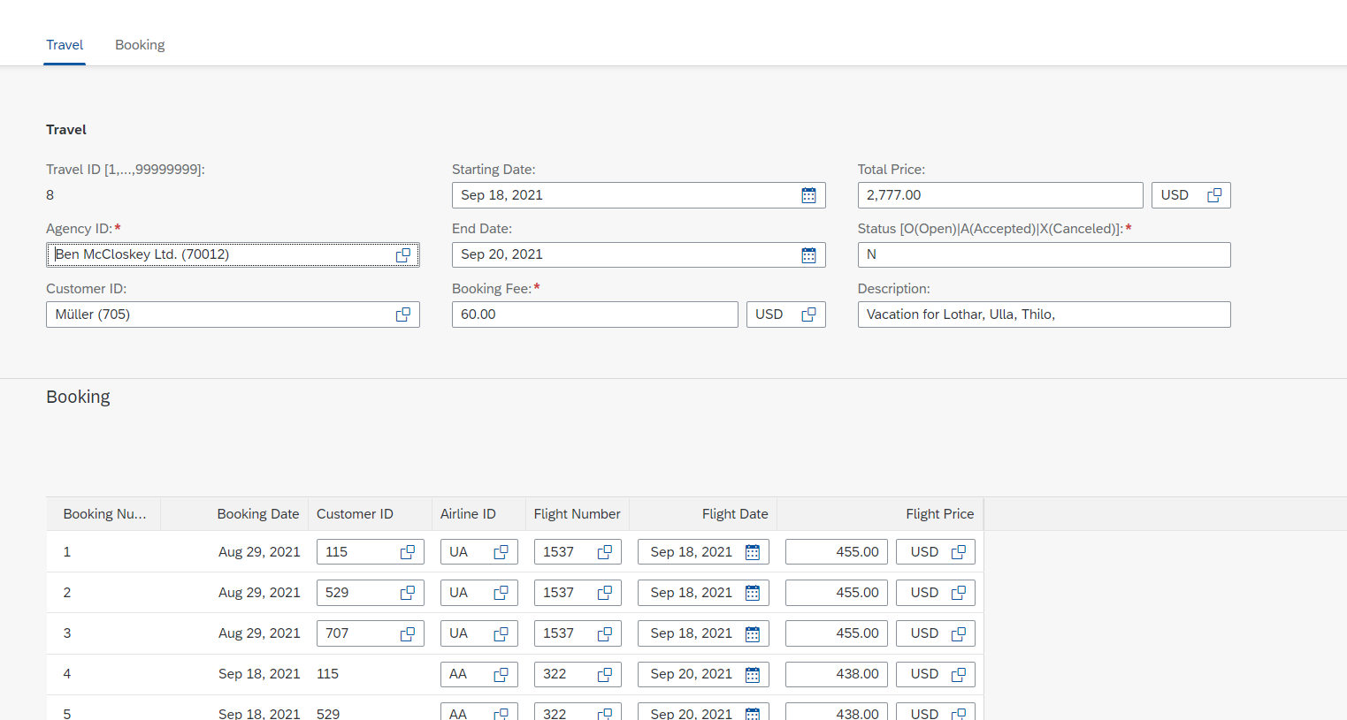
Testing composition
We should be able to create Travel request with bookings.

Slide 27
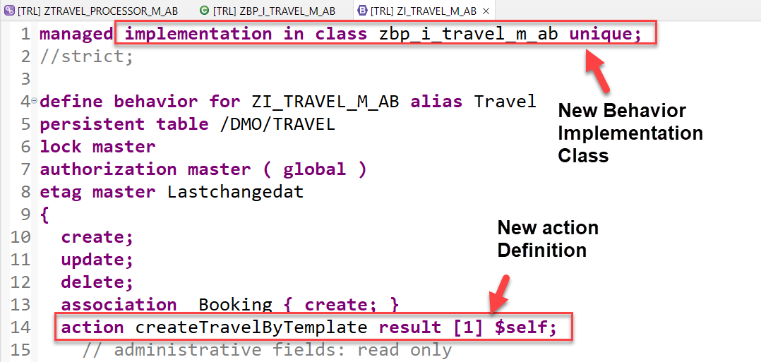
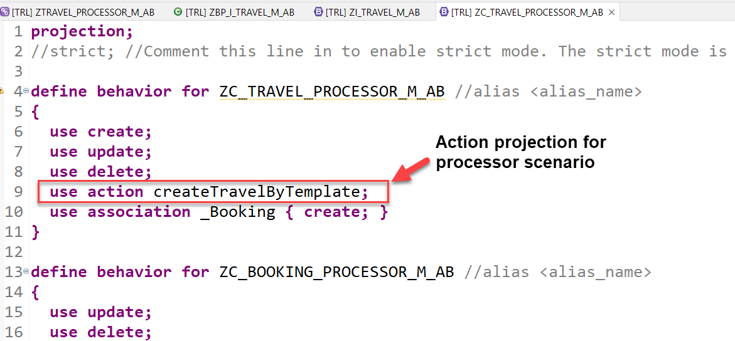
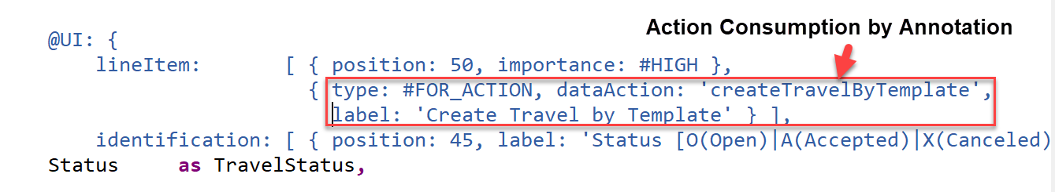
Implementing Action “createTravelByTemplate”
This action provides a template for creating a new travel based on an already existing travel instance.
Exercise
Create Travel By Template Action Code

Slide 28
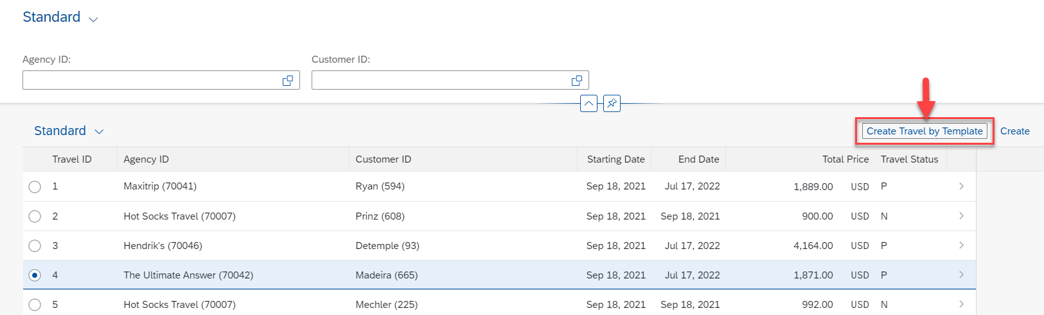
Result of Action Implementation
Check how the UI of a Fiori application looks like or refresh the browser where Fiori app is displayed.

Slide 29
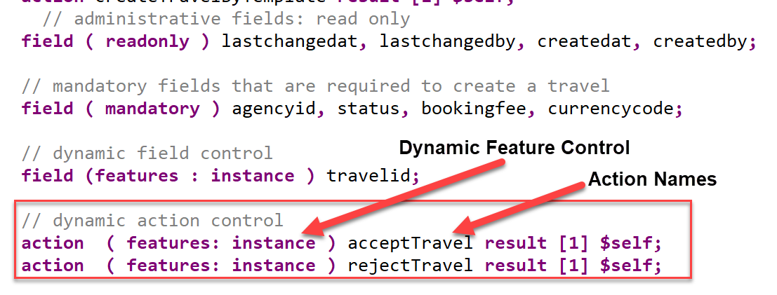
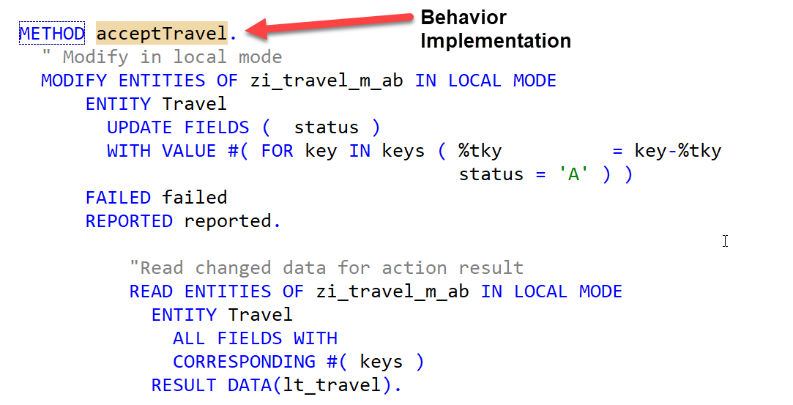
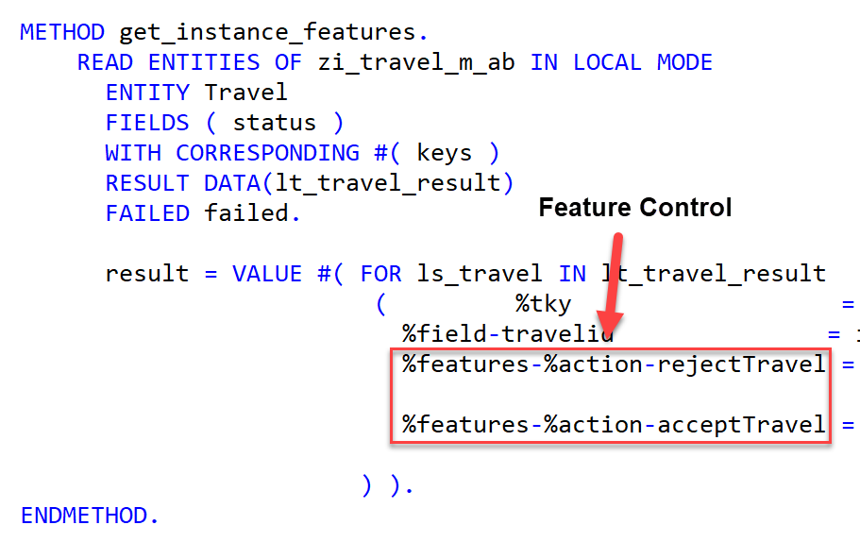
Implementing Action “approve/rejectTravel”
These 2 actions are going to be used later in approver scenario and also have dynamic feature control
Exercise
Approve/Reject Action Code

Slide 30
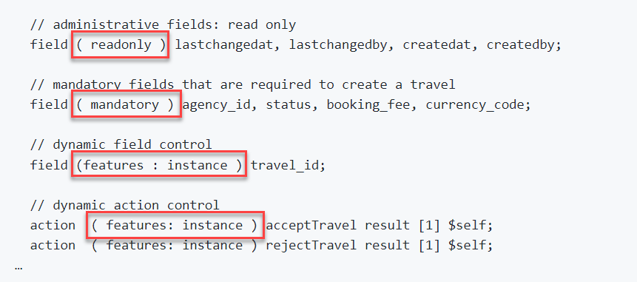
Modeling Static and Dynamic Feature Control
As an application developer you may want to determine, which entities of your business object should be create-, delete- and update-enabled, so that they can be modified during consumption using EML or OData services. In addition, you also may want control which (UI) fields of an entity are read-only or which actions in which usage scenarios are enabled or disabled for execution by the end users.
In ABAP RESTful programming model, the feature control is precisely the means of accomplishing such tasks. It allows you to control the visibility and changeability of fields, operations or entire entities.
Depending on whether feature control refers to specific instances or is independent of each entity instance, we distinguish between instance-bound and static feature control.
The availability of feature control values is modelled in a behavior definition. Unlike static, instance-bound feature control requires not only a definition but also an implementation in a handler class of the behavior pool. Therefore, we also talk about dynamic feature control in case of instance-bound feature control.
Both, static and dynamic feature control is defined for different levels (entity, field, or action level) in the behavior definition by using the following syntax:
Exercise
Dynamic Feature Control Code

Slide 31
Requirements
Make Administrative fields for Travel as Read Only
Make Travel Fields Mandatory for booking
Control the Accept and Reject Travel actions based on status
Make Connection fields mandatory for Booking
Control the Customer ID field based on Carrier, For AA make it Read only

Slide 32
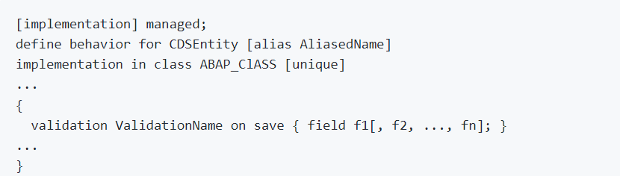
Implementing Validations
A validation is an implicitly executed function intended to check the data consistency of an existing instance of an entity (consistency validation). It is implicitly invoked by the business object’s framework as soon as a trigger condition at a predefined point in time is fulfilled. Validation can return messages to the consumer and reject inconsistent instance data from being saved.
Validations never modify any instance data but return the messages and keys of failed (inconsistent) entity instances.
Validations are specified for individual business object’s entities in the behavior definition by using the following syntax:

Slide 33
F1
F2 1 → 2
F3
Save
If f1 is not initial
If f2 is not initial
select * checktable where exist f2
If f3 is not initial
check itab has f3

Slide 34
Use case for Validation
Check if the customer ID referenced in the Travel order is valid.
Check if the travel end date is more than Travel Start Date
Check if the status passed by User is valid.
These validations are assigned to the "Travel" entity having defined update as the trigger operation on entity "Travel". As soon as data is updated by the consumer, the validation will check it and return a warning message if the unusual condition arrives.
Exercise
Validation Code

Slide 35
Implementing the Determination
A determination is an implicitly executed function that handles side effects of modified entity instances. It is invoked by the business object’s framework as soon as a determination’s trigger condition at a predefined point in time, the determination time, is fulfilled.
Determinations are triggered internally based on changes made to the entity instance of a business object. The trigger conditions are checked by business object framework at different points during the transaction cycle, depending on the determination time and the changing operations on the relevant entity instances. For each determination, it is necessary to specify both the determination time and the changes that form the trigger condition. A trigger condition consists of a list of fields belonging to the same entity the determination is assigned to and the changing operations that include creating or updating entity instances. We call this operations trigger operations.
In case a field is changed (after creation or update), the condition is fulfilled. The framework evaluates the triggering condition of all determinations at certain points in time (determination time). For determinations, this is today either after each modification or during the save phase.
You can use a determination primarily to compute data that is derived from the values of other fields. The determined fields and the determining fields either belong to the same entity or to different entities of a business object.
As a result, determination can modify entity instances and return transition messages (error, warning, information, success).

Slide 36
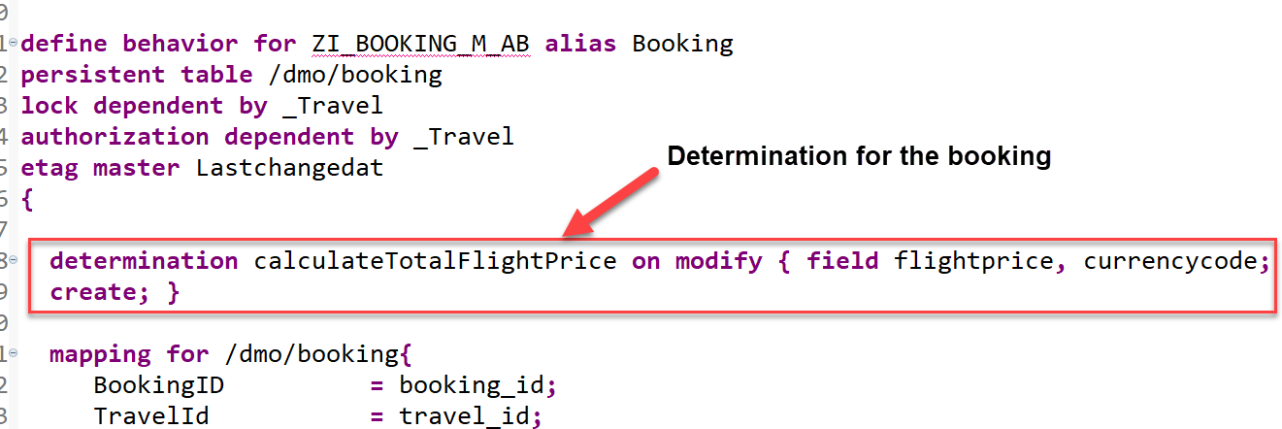
Implementing the Determination
The determination calculateTotalFlightPrice on the booking entity is intended to handle the calculation of total price of all flight bookings that belong to the selected travel.
The determination will be triggered by on modify as determination time when creating new booking instances or updating the flight price value or when changing the currency. In other words: both fields flight_price and currency_code serve as trigger fields and form together with create and update operations the trigger condition for the determination.

Slide 38
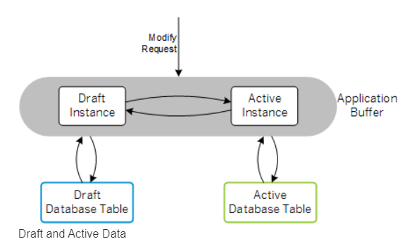
What is Draft?
You can draft-enable a business object to automatically persist transactional data in the backend. This approach supports stateless communication for your applications.
Modern cloud-ready apps require a stateless communication pattern, for example to leverage cloud capabilities like elasticity and scalability. Thus, there is no fixed backend session resource along a business transaction for each user and the incoming requests can be dispatched to different backend resources, which supports load balancing. On the other hand apps are stateful from end-user perspective. Business data that is entered by the end user needs to be locked, validated and enriched via ABAP business logic on backend side.
The draft concept fills the gap between a stateless communication pattern and a stateful application by applying REST principles:
The draft represents the state and stores the transactional changes on the database in shadow tables. It is an addressable resource, the exact copy of the active data that is currently being edited.
Draft-enabled applications allow the end user to store changed data in the backend and continue at a later point in time or from a different device, even if the application terminates unexpectedly.

Slide 39
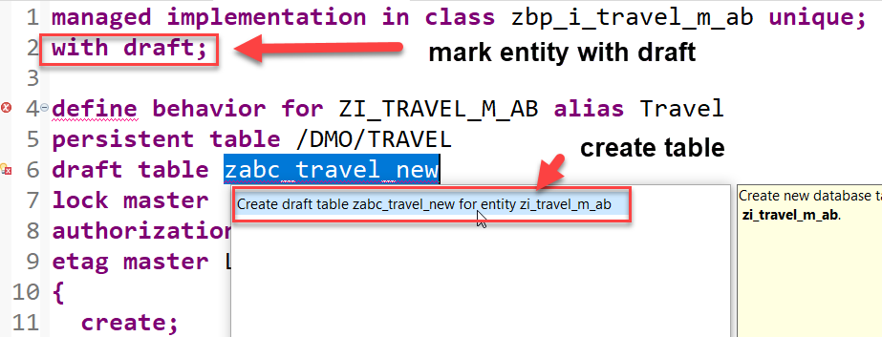
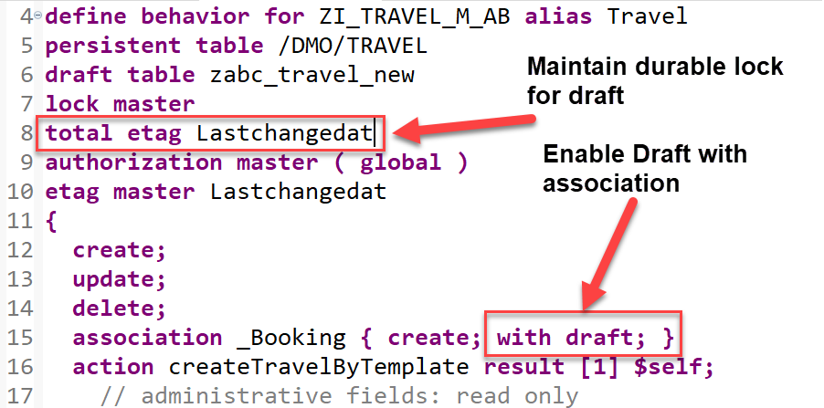
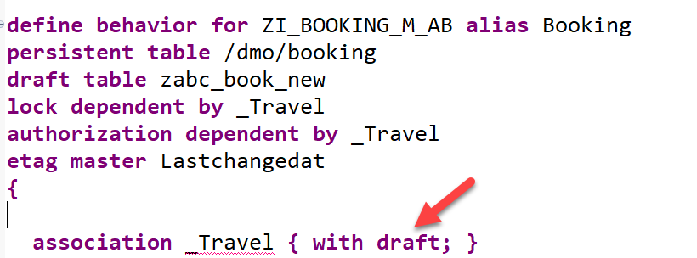
Steps to implement Draft
Draft tables are fully managed by the RAP framework at runtime
Add the addition with draft; after the managed; keyword in the header section to enable draft handling for your business object.
Specify the draft table for the travel & booking entity, where the draft travel data will be persisted as show on the screenshot.
Replace the association definition in the base behavior definition to solve the warnings indicating that the associations are implicitly draft enabled as this is a draft enabled business object. For this, use the code snippet provided below to replace the one currently defined in the travel behavior definition as shown on the screenshot. Do the same for the _Travel association.
Specify a total etag field in the root entity of your BO. This is required to identify changes to active instances in cases where the durable lock has expired. The field LastChangedAt will be used for the purpose in the present scenario.

Slide 40
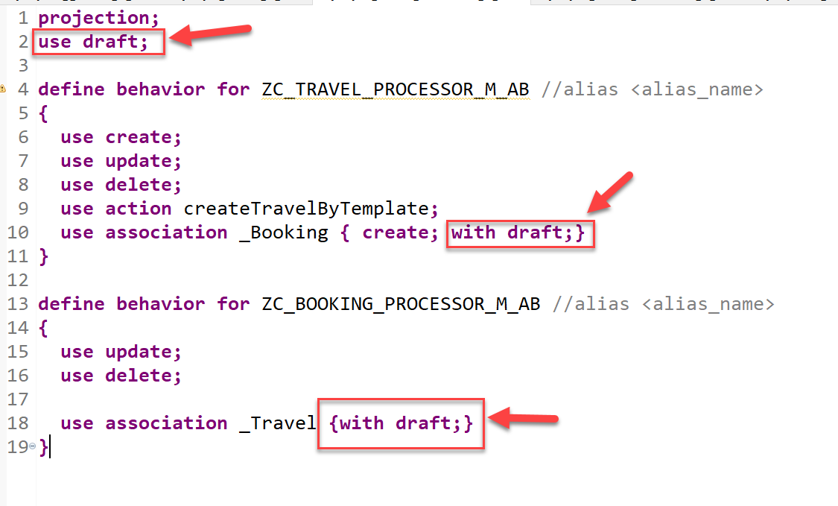
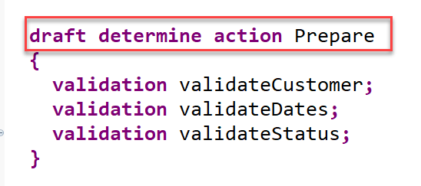
Steps to implement Draft
5. When a draft instance is going to be activated, the SAP Fiori elements UI calls the draft determine action prepare in the backend. This call takes place in a separate OData changeset to allow for saving the state messages even in case the activation fails due to failing validations. In order to execute the validations during prepare, you need to assign them to the draft determine action prepare trigger.
6. At Last, we will enable the draft handling for the managed based business object (BO) with a few additions in the behavior definition.
Draft Implementation Code

Slide 41
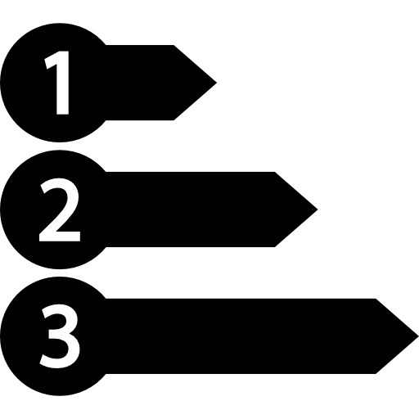
Enable Early Numbering for Travel and Booking
About Numbering
Numbering is about setting values for primary key fields of entity instances during runtime.
The primary key of a business object entity can be composed of one or more key fields, which are identified by the keyword key in the underlying CDS view of the business object. The set of primary key fields uniquely identify each instance of a business object. The primary key value of a business object instance cannot be changed after the CREATE.
There are various options to handle the numbering for primary key fields depending on when (early or late during the transactional processing) and by whom (consumer, application developer, or framework) the primary key values are set. You can assign a numbering type for each primary key field separately.
Early and Late Numbering
In an early numbering scenario, the primary key value is set instantly after the modify request for the CREATE is executed. The key values can be passed externally by the consumer or can be set internally by the framework or an implementation of the FOR NUMBERING method. For more information, see Early Numbering.
In a late numbering scenario, the key values are always assigned internally without consumer interaction after the point of no return in the interaction phase has passed, and the SAVE sequence is triggered. This ensures a gap free key value assignment like it is required for example for invoices. For more information, see Late Numbering.

Slide 42
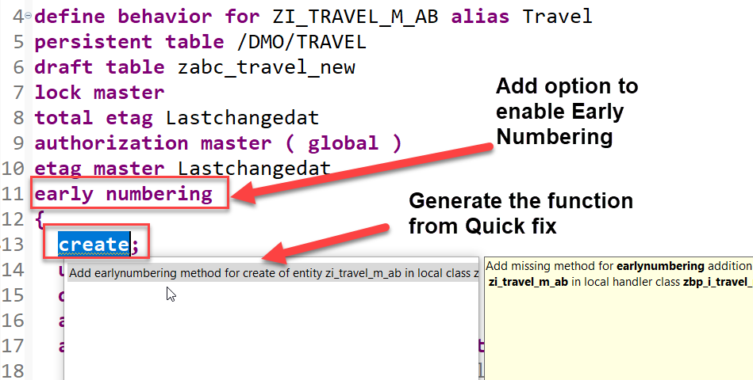
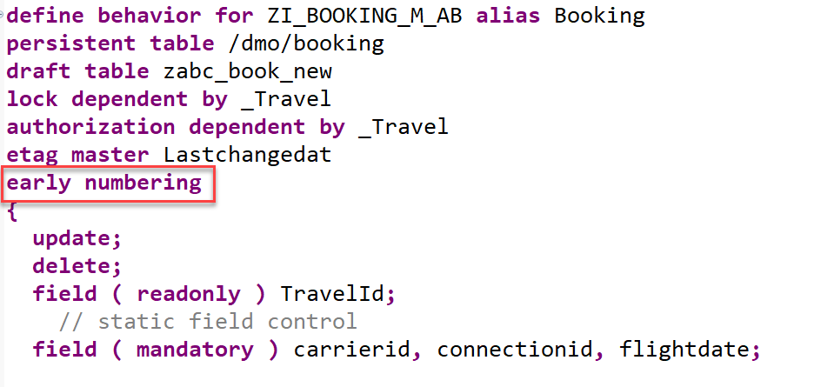
Implementation for Early Numbering
Add the addition early numbering keyword as shown below to enable early numbering for your travel entity.
The ADT Quick Fix feature can be used to add the earlynumbering method for travel entity.
Implement the function to handle early numbering – code here
Repeat the same for the booking by adding early numbering
Implement the function to handle early numbering – code here

Slide 43
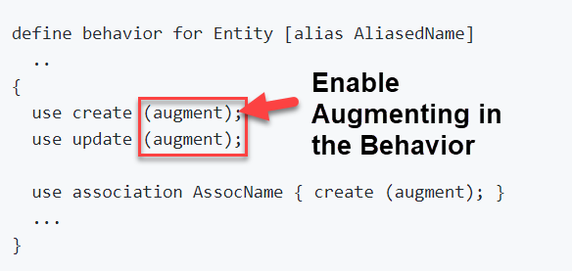
What is Augmenting
With an augmentation implementation you can add data or modify incoming requests on the projection layer before data reaches the transactional buffer. You can add data to a modify request or issue additional requests by augmenting the operation before the request is passed to the base business object.
Use case
• Defaulting for incoming requests.
• Behavior-enabling denormalized fields, for example enabling editing of language dependent fields.
Definition
Augmentation is defined in the projection behavior definition on the relevant operation with the following syntax:

Slide 44
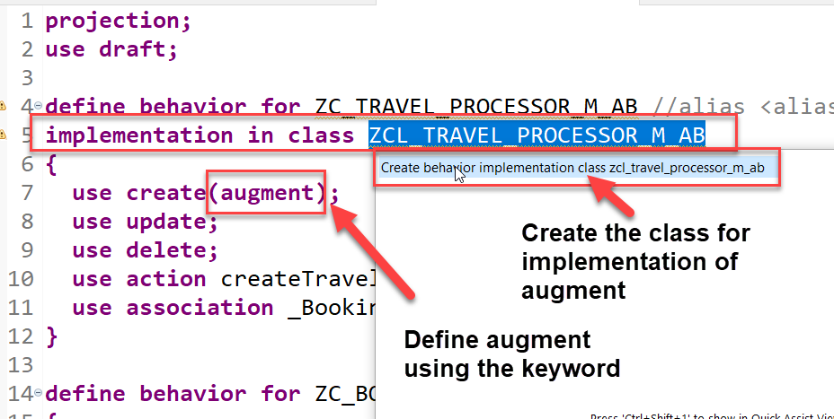
Use case and Implementation
We want to auto populate the agency id and the status of a new travel request during creation. The business has already provided default values which needs to be made available on fiori app.
Process
In our projection behavior definition, define augmentation for the create operation.
Add behavior implementation class to the Travel behavior.
The ADT Quick Fix feature can be used to create implementation class for travel entity.
Write the code to implement the default values for the agency id and status- Code here

Slide 45
Understand the Persona for Approver
The business object projection is the basis for a UI service that contains the functionality that is relevant for an approver. Imagine a person, maybe a manager of a travel agency, that approves the data that was entered by the processor. That means, this person sees the travel information and the corresponding booking data. Based on this data, the approver can either accept or reject the travel. For a minimal scope of fields in the travel entity the approver is enabled to edit the values, for example the BookingFee or the Description. The information about bookings is set to read-only for the approver. The approver is not allowed to change the fields of the booking entity.
Approver
Accept
Reject

Slide 46
Approver Scenario
Travel Projection CDS View for Approver BO
Except for the actions, which are different in the processor and the approver projection, the CDS projection views for the processor and the approver BO are identical. Minor changes can be detected in the field label of the field TravelID and TravelStatus. This results from the fact, that the approver does not create new travel entries. It is not necessary for this role to know the number range of the TravelID or the possible values of the TravelStatus. In addition, the approver BO projection has gained a selection field for the TravelStatus to make it easier for the approver to filter for open/accepted/rejected travels.
Actions
The position and the label for the action button must be defined in the CDS projection views. In the case of an approver, the available actions concerning the travel entity set are Accept Travel and Reject Travel. The implementation of these actions is done in the behavior implementation . It is simply the UI appearance that needs to be configured in the projection view. The action buttons for the respective actions are designed to appear on the travel list report page and on the travel object page. That is why the annotations are used in the list item and identification UI annotation. When executing the action on the list report page, a travel instance must be selected to assign an instance for the instance-bound action. On the object page, the instance for which the action shall be executed is clear.
Booking Projection CDS View for Approver BO
The CDS projection views for the processor and the approver BO are almost identical.
Value helps are not necessary for the interpretation of the approver role in this scenario. As the booking entity is a read-only entity in this scenario and selection fields with value helps cannot be defined for a sub entity, value helps cannot be applied and thus are not necessary to be defined for the booking entity.

Slide 47
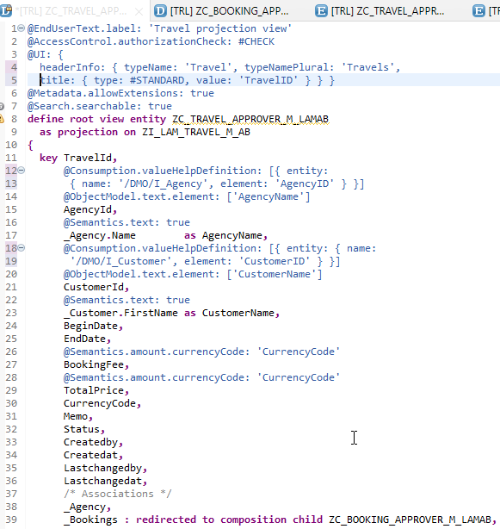
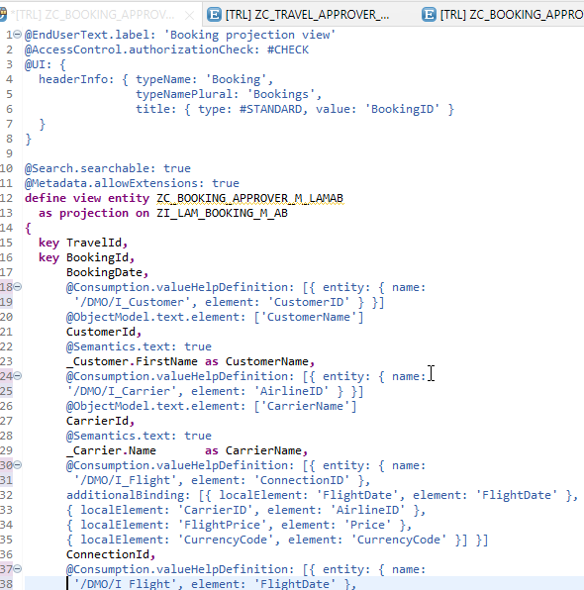
Implementing Approver Projection CDS
ZC_TRAVEL_APPROVER_M_LAMAB
ZC_BOOKING_APPROVER_M_LAMAB

Slide 48
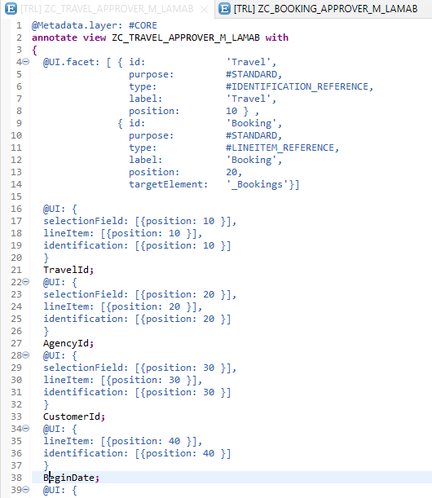
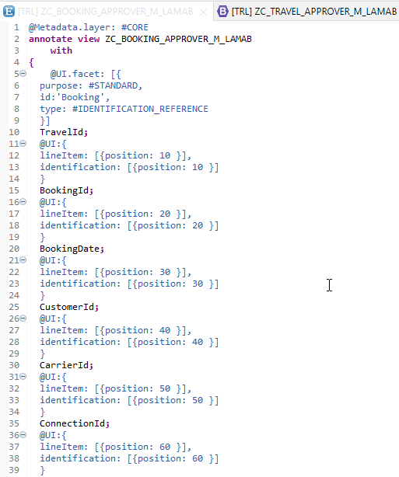
Metadata Extension
Metadata Extension for Travel
Metadata Extension for Booking

Slide 49
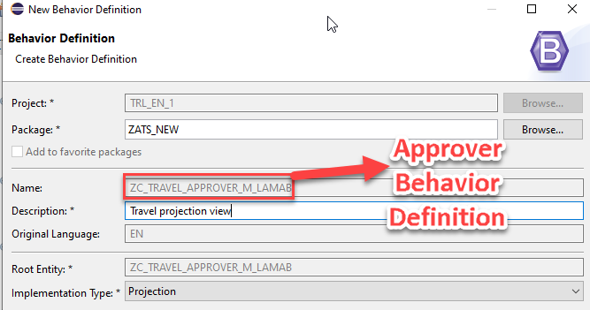
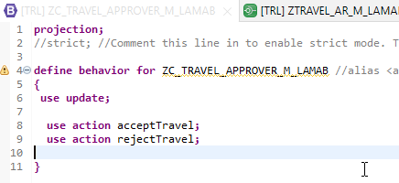
Behavior Definition for Approver
The scope of the UI service for the approver is more limited than for the processor. The approver can only modify the travel entity with accepting or rejecting the travel entries. The values in the corresponding booking entries are the basis for this decision-making.
The behavior for the BO projection is defined in a behavior definition of type projection. The type is defined in the behavior definition header. The projection behavior definition provides the behavior for the projection CDS view. All characteristics and operations that you want to include in the BO projection must be listed explicitly. The keyword for this is use. - Code here

Slide 50
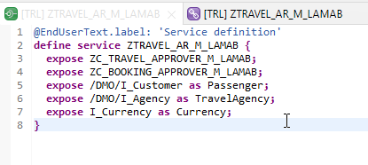
Service Definition
The service definition is a projection of the models and related behavior that you want to expose.
In a service definition, you define the OData service to determine which CDS entities are part of the service. This service is then bound to a protocol and to either a UI technology or an A2X service by a service binding artifact. A service definition can be integrated in various protocols without any reimplementation.
Service definition is used to assign the scope of the OData service. Travel, Booking, Passenger, TravelAgency, Currency CDS views are exposed in the service definition. Optionally, you can assign an alias for the each exposed CDS view
Exercise
Service Definition

Slide 51
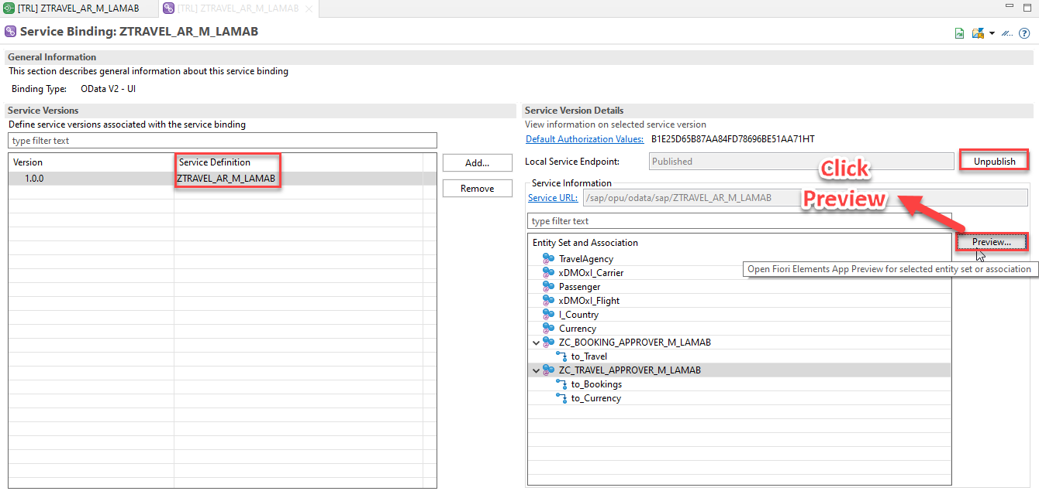
Service Binding
A service binding implements the protocol that is used for the OData service. It uses a service definition that projects the data models and their related behaviors to the service.

Slide 52
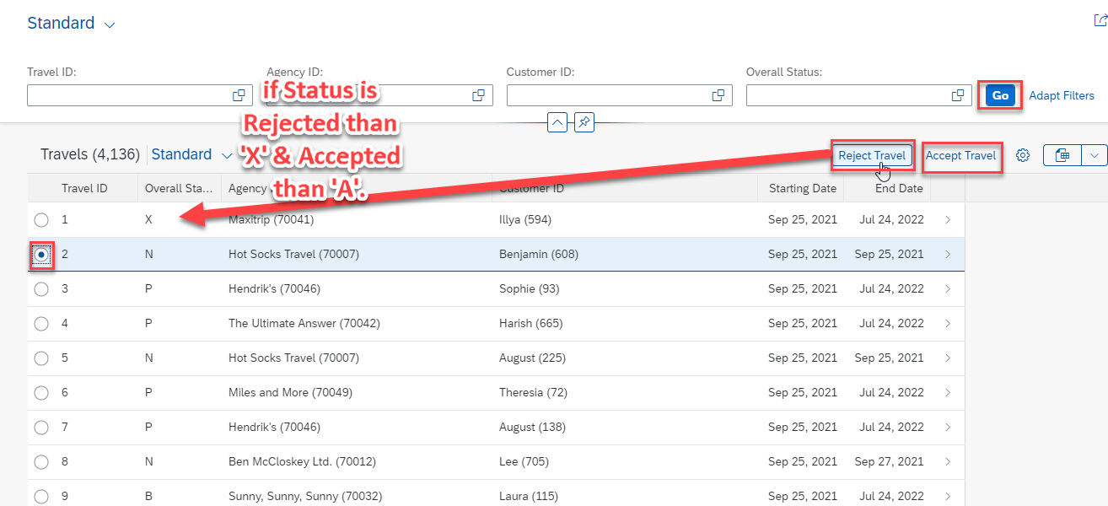
Fiori App Preview

Slide 53

End of Day 05
Trainer: Anubhav Oberoy

Slide 54
Trainer: Anubhav Oberoy

Slide 55
THANK YOU
If you cannot do
great things, do small things in a great way.
Anubhav Oberoy
https://www.anubhavtrainings.com

Slide 56


We’re committed to empower you to be
Most Desirable Resource
through powerful training solutions.
We build the workforce of the future.
250+
Corporate Clients
30,000+
Learners Trained
25000+
Learners Placed
FREE WEBINARS
Sign up for free webinars with industry experts every fortnight!
Enroll Now!
Contact us today!
https://anubhavtrainings.com/

Slide 57




More from AnubhavTrainings.com

